Slide 1
Workshop Nearpod
23 January 2014
Trial and Error

Slide 2
Programme:
Short explanation Nearpod
Explanation assignment
Create your own presentation nearpod (2 persons)
Test your nearpod presentation
Nearpod presentation for the whole group
Diner
Workshop Nearpod - Programme

Slide 3
Workshop Nearpod - Nearpod – Computer - Browser

Slide 4
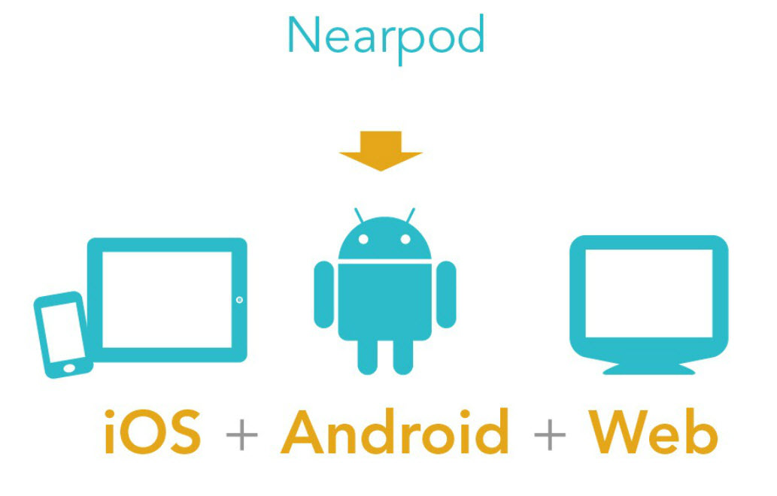
Workshop Nearpod – Platforms

Slide 5
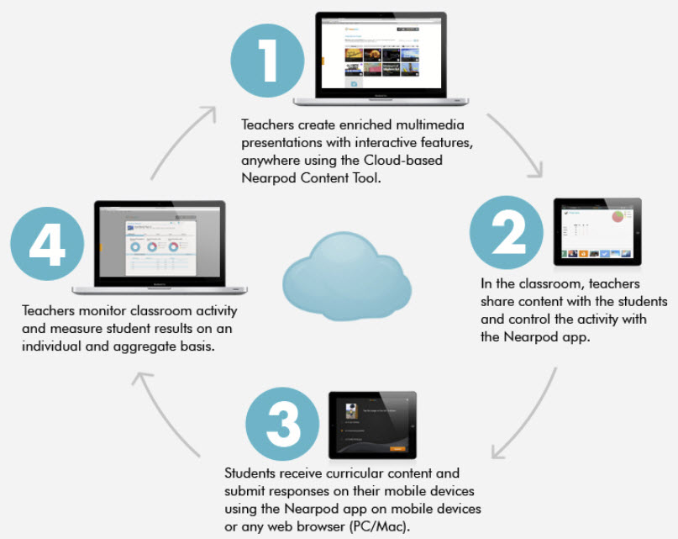
Workshop Nearpod – What is Nearpod?

Slide 6
Workshop Nearpod – Presentation Modes

Slide 7
Create a new Nearpod account – www.nearpod.com
Workshop Nearpod - Account

Slide 8
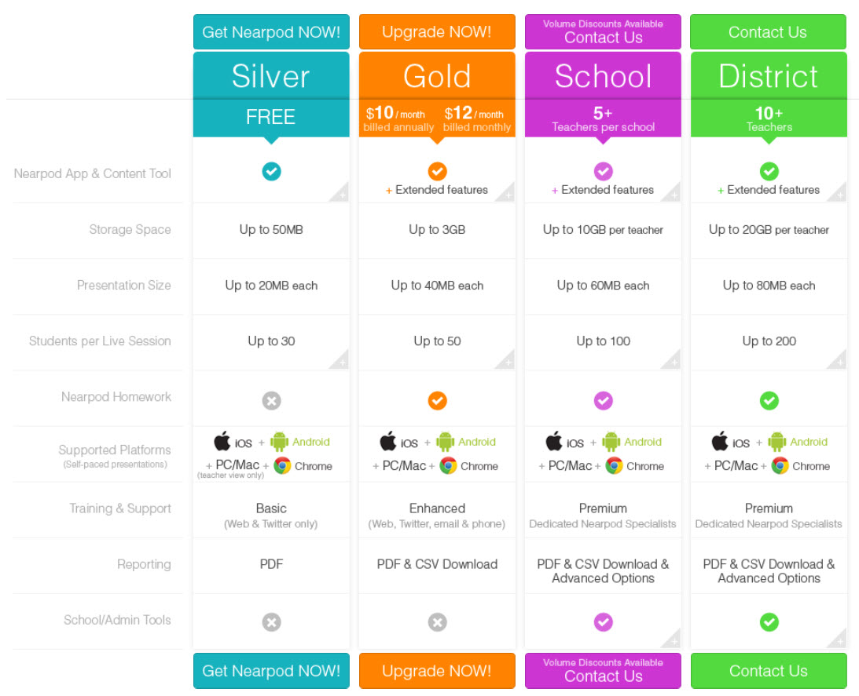
Workshop Nearpod – Types of accounts

Slide 9
Workshop Nearpod – Free Nearpod Presentations

Slide 10
Workshop Nearpod – Content Presentation

Slide 11
Workshop Nearpod – Content Presentation Activities

Slide 12
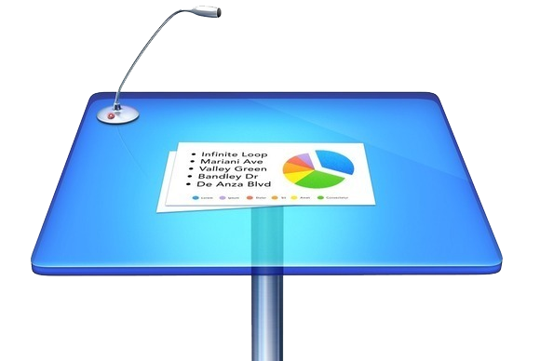
Workshop Nearpod – Powerpoint/Keynote

Slide 13
Workshop Nearpod – Photoshop
(1024 x 768)

Slide 14
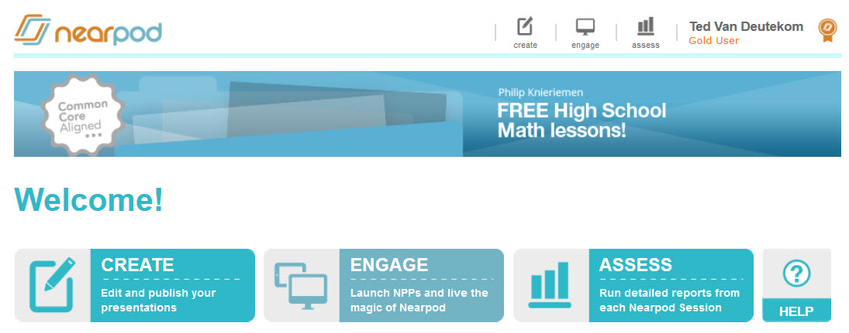
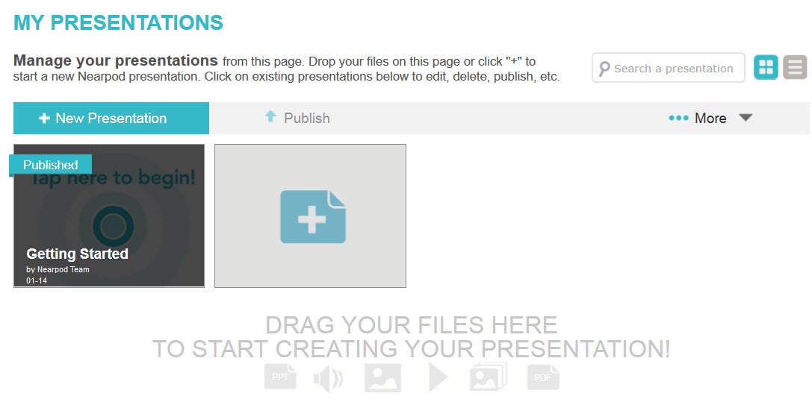
Workshop Nearpod – Create New Presentation

Slide 15
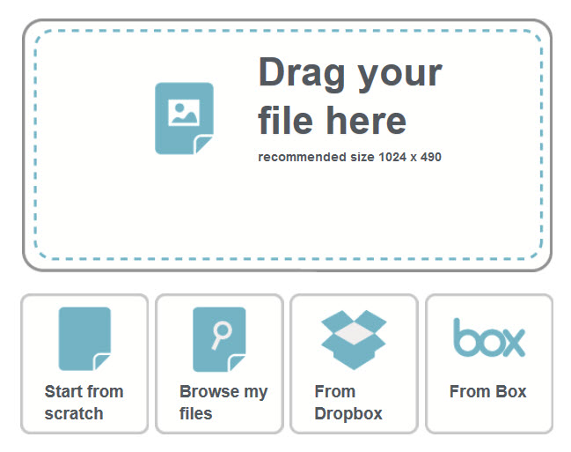
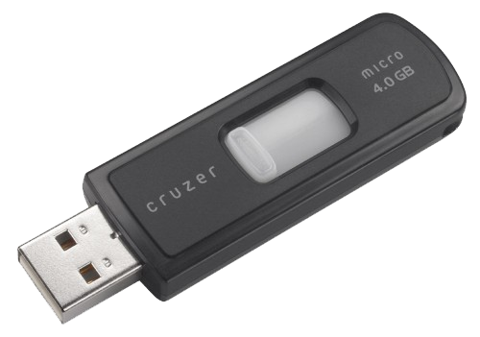
Workshop Nearpod – Import Pdf

Slide 16
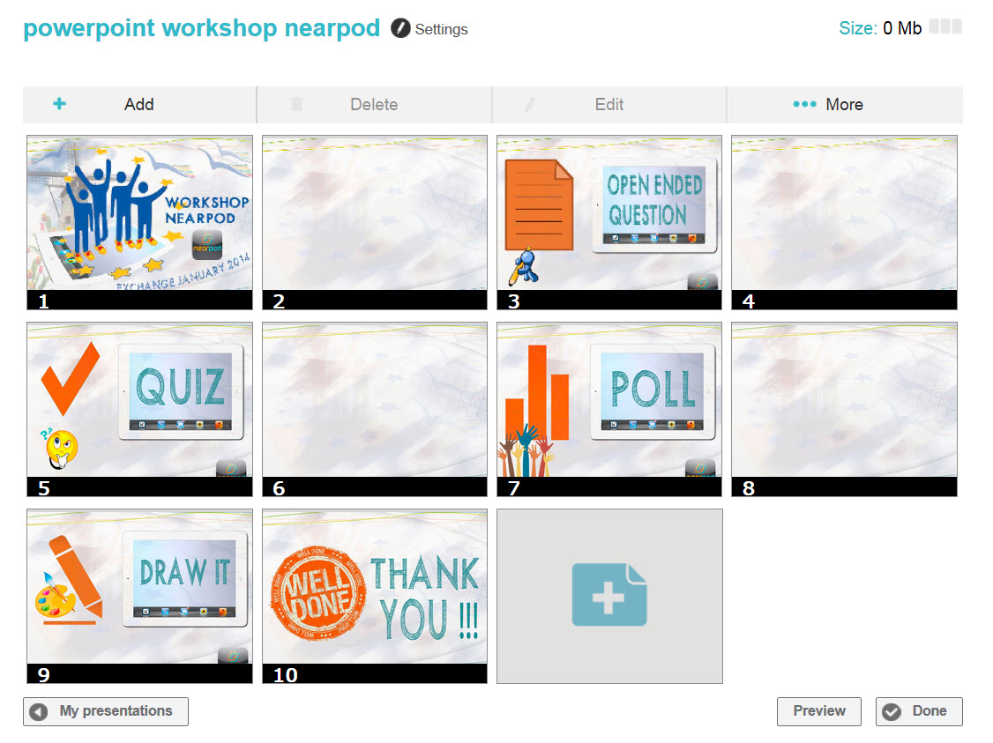
Workshop Nearpod – Add Activity

Slide 17
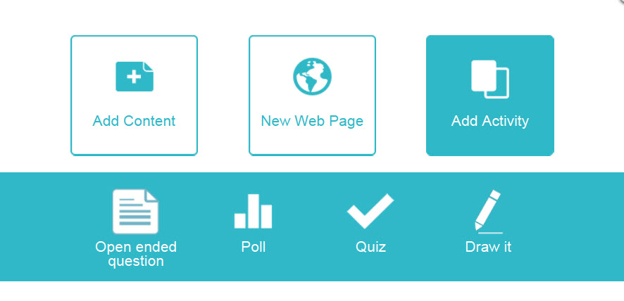
Workshop Nearpod – Add Activity

Slide 18
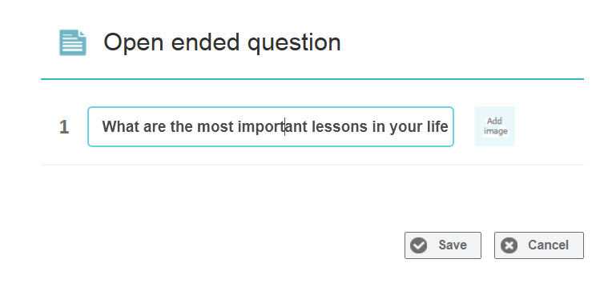
Drag
Workshop Nearpod – Open Ended Question

Slide 19
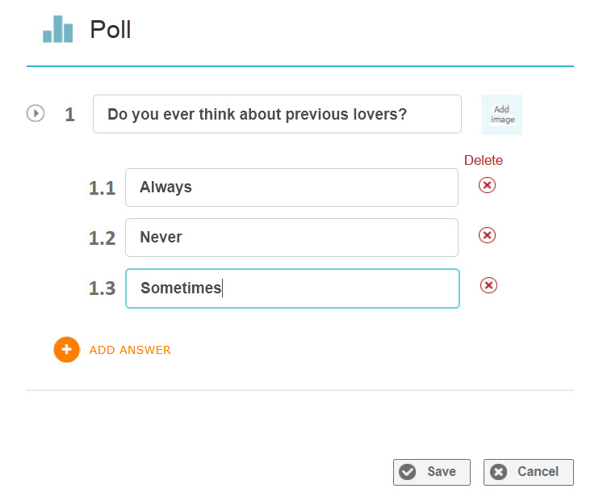
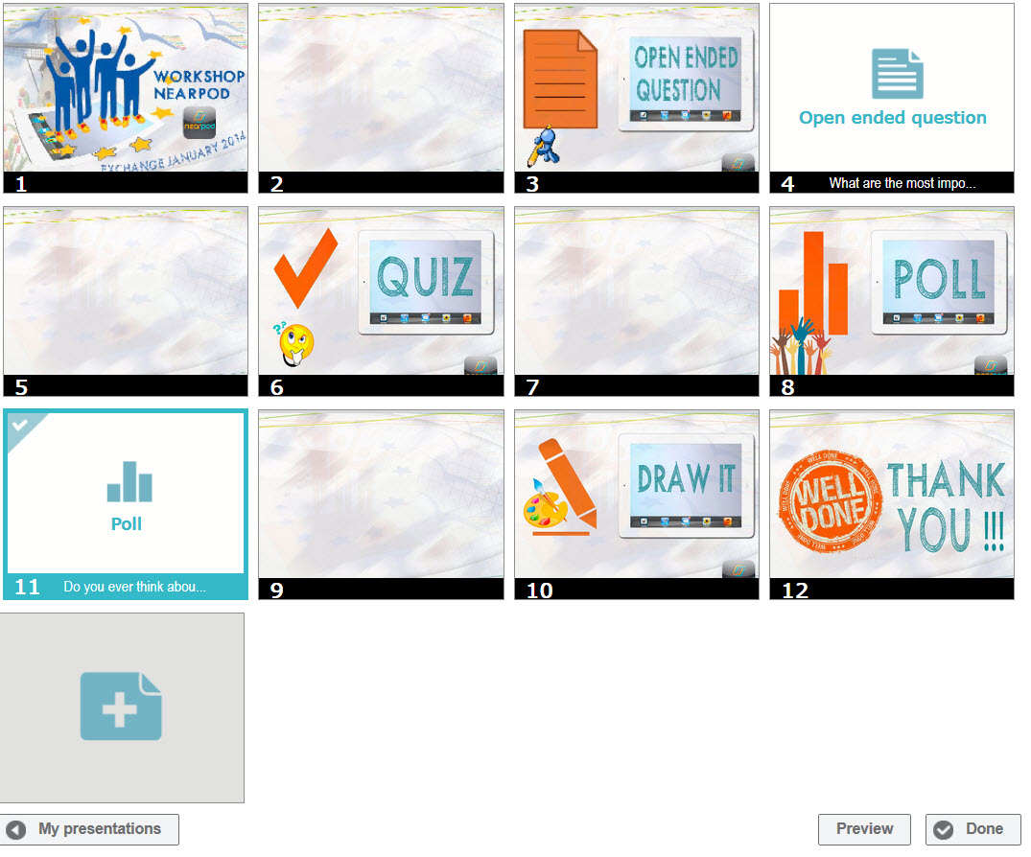
Workshop Nearpod – Poll

Slide 20
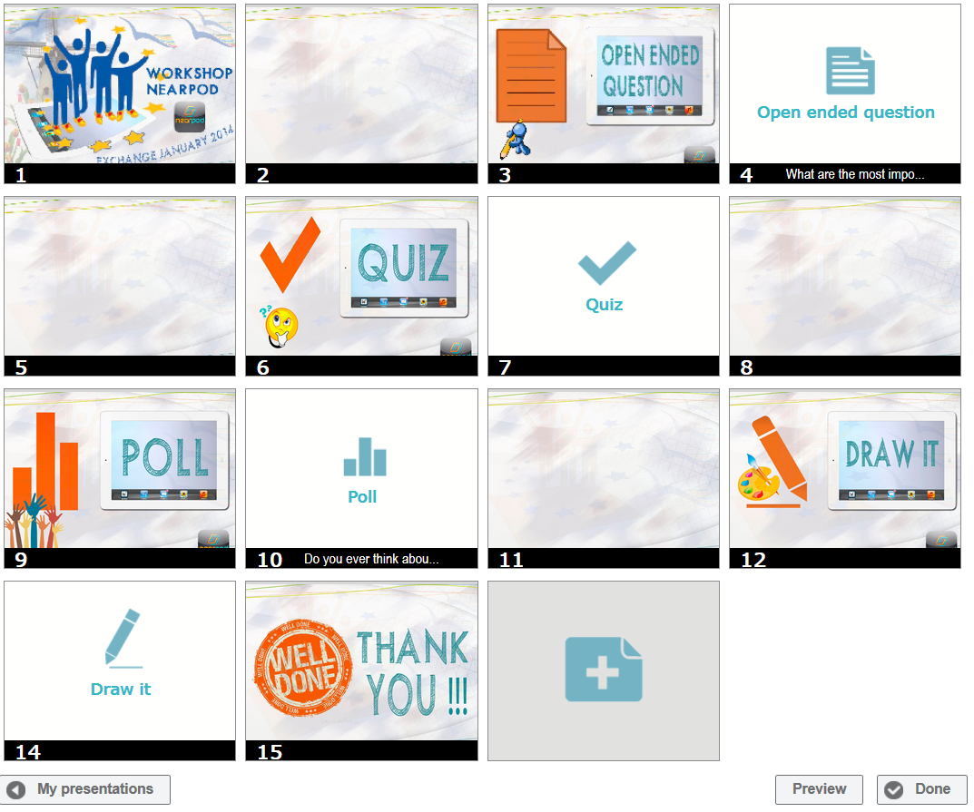
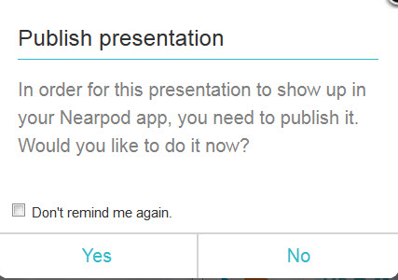
Workshop Nearpod – Publish Presentation

Slide 21
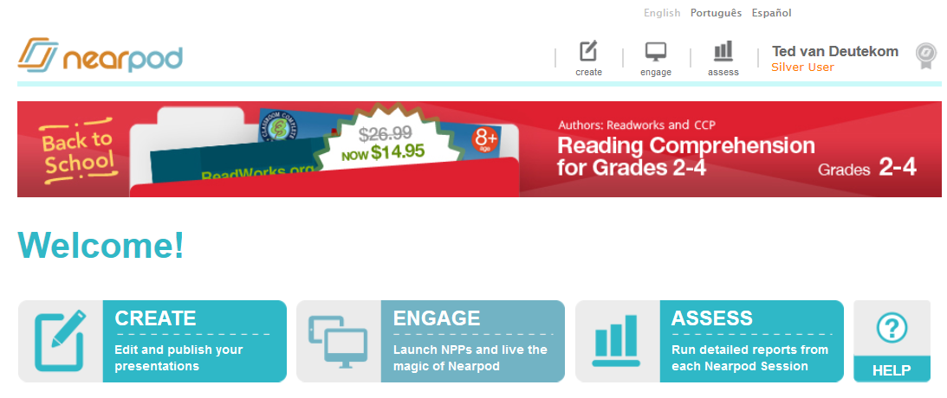
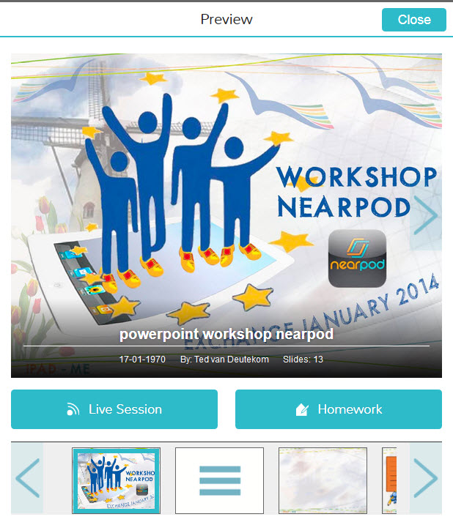
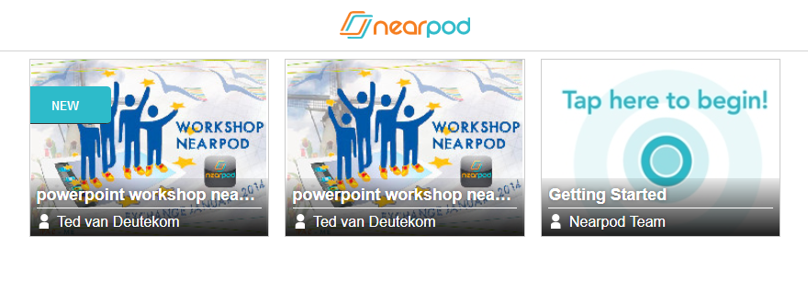
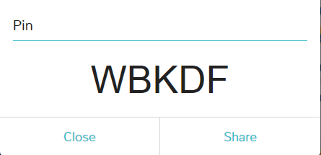
Workshop Nearpod – Live Session

Slide 22
Assignments:
Create an acount
Open in Powerpoint: Workshop Nearpod.pttx
Add text and pictures (explanation) in the blank slides
Save your presentation
Export your presentation to PDF-file
Create your presentation in nearpod (add activities)
Test your nearpod presentation
Nearpod presentation for the whole group
Workshop Nearpod -Create your own presentation
Nearpod
Open ended question
Quiz
Poll
Draw it
……

Slide 23
Workshop Nearpod

